Slide 1
Introduction to Phage Commander
Phage Commander is a software tool for identifying genes in phage genomes
Phage Commander runs a phage’s DNA sequence through gene identification tools and outputs a list of potential genes. These tools include:
Glimmer, Genemark, Genemark.hmm, Genemark S, Genemark S2, Genemark Heuristic, Prodigal, RAST, Metagene, and Aragorn (for tRNA genes)
Phage Commander’s output can be exported in Excel format (.xlsx) or NCBI GenBank format (.gb)
A draft paper describing Phage Commander in detail is here: https://www.biorxiv.org/content/10.1101/2020.11.11.378802v1

Slide 2
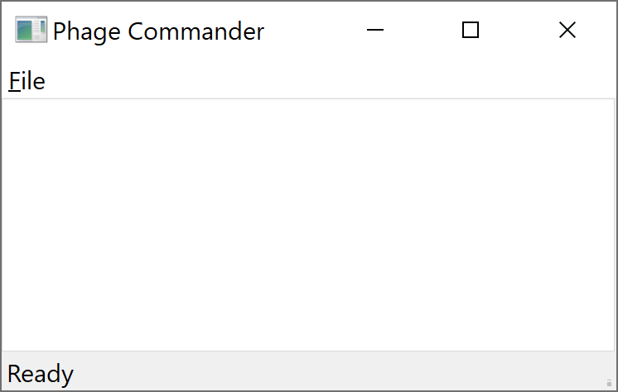
How to run Phage Commander
Download Phage Commander from GitHub repository: https://github.com/sarah-harris/PhageCommander
Run Phage Commander:
Windows: Navigate to phagecommander/bin. Click on the executable: phagecom-windows.exe
Linux or Mac: Open a shell. Navigate to folder where you have downloaded phagecommander. Type py phagecom.py. If you need to install any of the supporting packages, first type: ‘pip install .’ (in the PhageCommander-master directory – the directory that contains setup.py)
A small Phage Commander window will appear:

Slide 3
How to use Phage Commander
In the Phage Commander Window, click on the File menu, and select New
A Select Query Tools window will open (see next slide). Select which tools you would like to use
If using GeneMark.hmm you will need to select your phage’s bacterial host from the drop down menu under Species
To use RAST, you will need to create a login and password at https://rast.nmpdr.org
Press Open and select your phage’s fasta file - an example fasta file is included in the GitHub repository: Patience.fasta
Press Query to run Phage Commander. Phage Commander will now run the phage genome through the selected tools – this may take several minutes
When Phage Commander completes, press OK

Slide 4
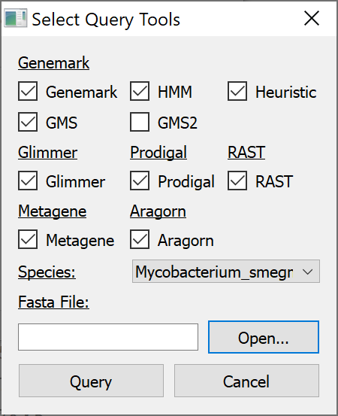
Select Query Tools Window
Check the boxes of the tools you want to use
Select host from drop down menu if “HMM” box is checked (GeneMark.hmm)
Press open select phage fasta file
Press “Query”

Slide 5
In the Event of an Error
If Phage Commander runs successfully, you will see a window saying “Done! Query Successful”
Press OK and you will see the Phage Commander output in the form of a spreadsheet (expand the window)
If phage commander encounters an error, the error message will display which program is causing the error (e.g. Glimmer, Aragorn, GMS2, etc.)
To work around this, re-run Phage Commander without including the program causing the error

Slide 6
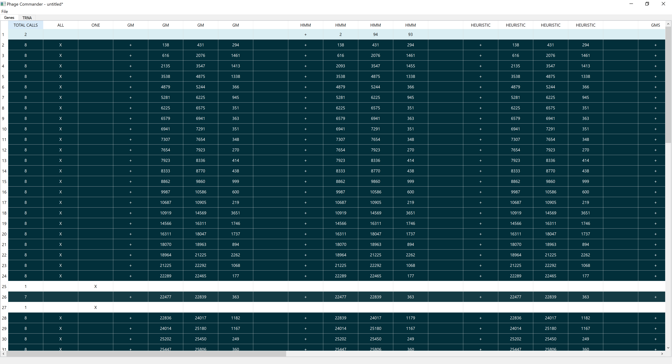
Total Calls column
Is the number of programs identifying a gene
“GM” is the genes identified by GeneMark
“HMM” is the genes identified by GeneMark.hmm
“Heuristic” is the genes identified by GeneMark Heuristic
Each row is a gene
Row shading is proportional to how many programs identify a gene (darker = more programs, white = only one program)

Slide 7
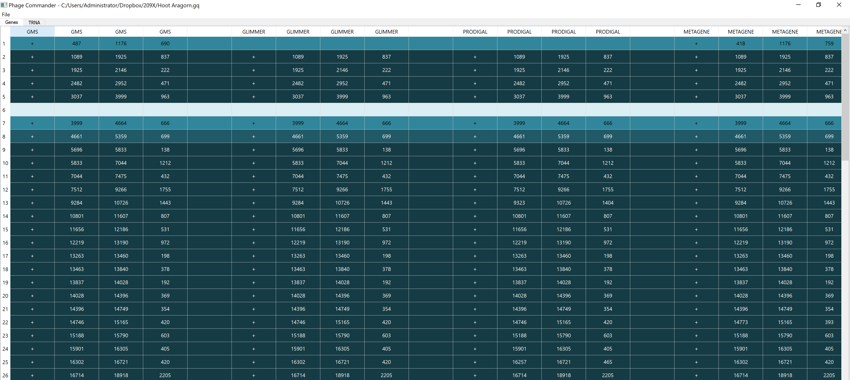
“GM” is the genes identified by GeneMark S
“Glimmer” is the genes identified by Glimmer
“Prodigal” is the genes identified by Prodigal
“Metagene” is the genes identified by Metagene
DNA strand (+ or -)
Gene start (stop if strand “-”)
Gene stop (start if strand is “-”)
Gene length

Slide 8
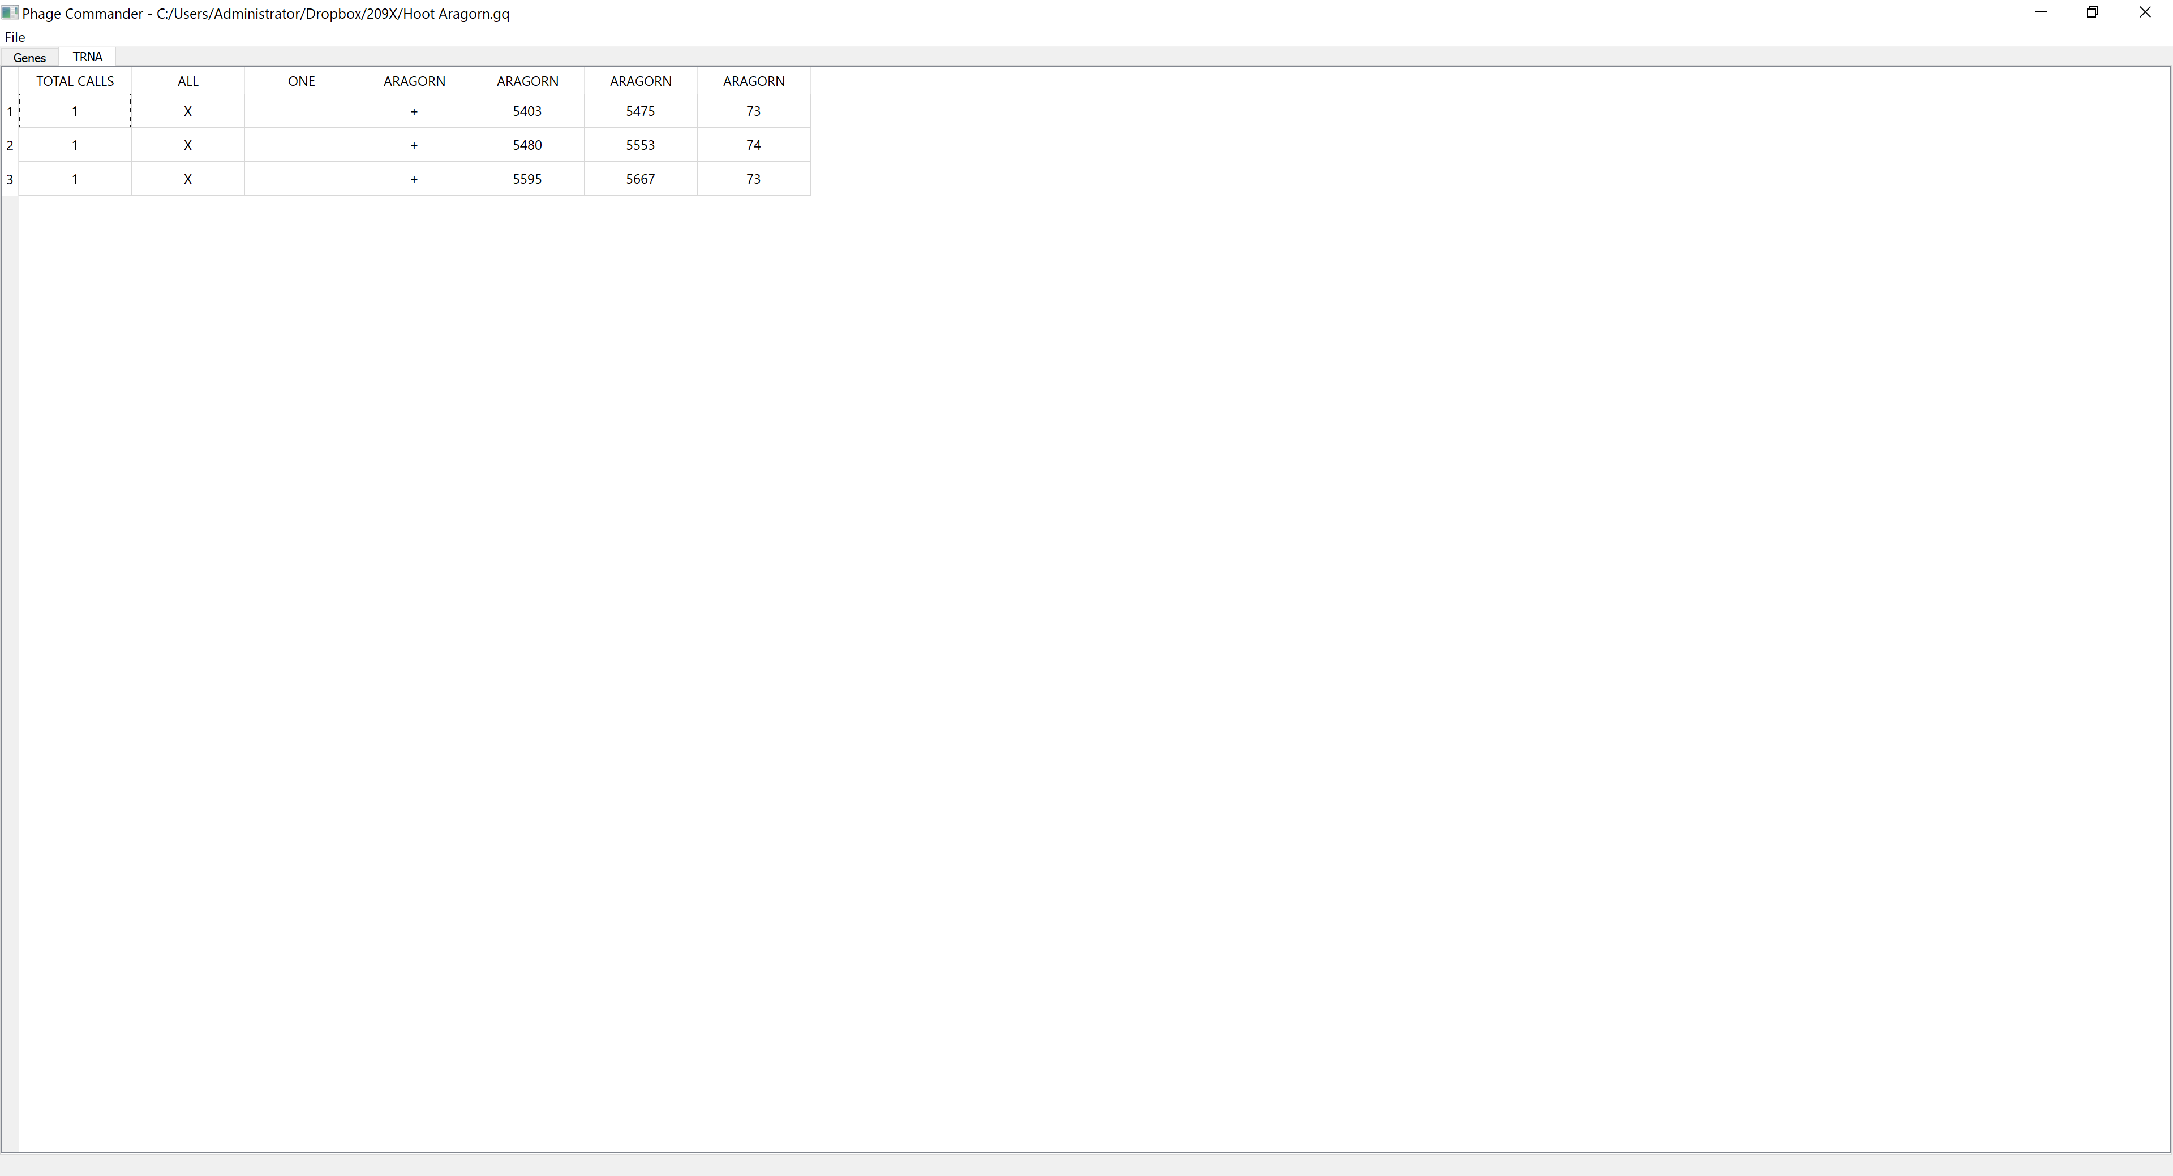
tRNA genes
Identified by Aragorn in “TRNA” tab
Total calls is always 1 since Aragorn is the only program for identifying tRNA genes

Slide 9
Exporting Phage Commander Results
To export as excel spreadsheet, select:
File → Export → Excel
To export as GenBank (.gb) format file, select:
File → Export → GenBank
Set the threshold number of programs for exporting genes
“Less than or equal to” will export those genes identified by an equal or lower number of programs than the threshold (e.g. genes identified by 3 or fewer programs. Set the threshold to maximum to export all genes identified)
“Greater than” will export those genes identified by a number of programs greater than the threshold (e.g. genes identified by more than 2 programs. Use “0” as the threshold and this setting to export all genes identified)
Press “Save as” and enter desired filename
Press “Export”

Slide 10
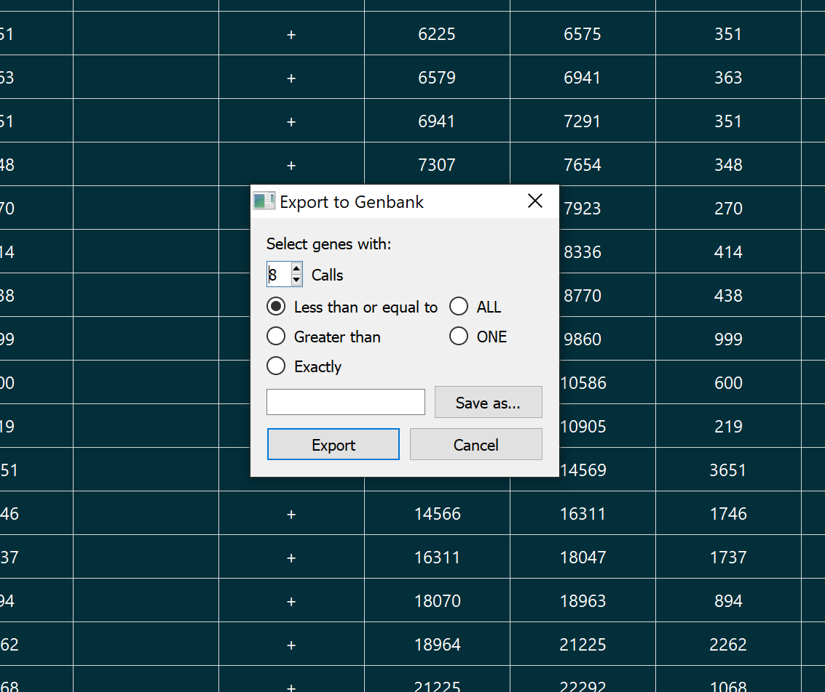
Exporting Phage Commander results in .gb format
User-set threshold number of programs
For gene exporting
Export only those genes identified by all programs (max)
Export genes identified by less than or equal the set number of programs
Export genes identified by
only one program
Export genes identified by more than the set number of programs
Press “Save as” and enter desired filename
Export genes identified only by set number of programs
Press “Export”

